Slide 1
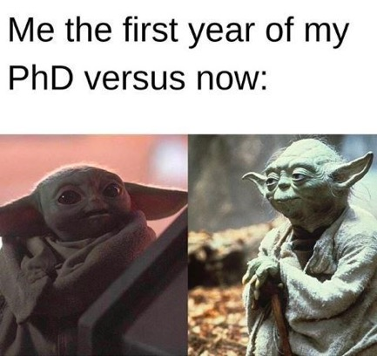
Collaborative & Reproducible Science
& what does that mean for my PhD?
Introductions to each other:
Introductions to the PhD, reproducibility & version control
Putting version control into practice
Notes:
Synopsis: This interactive session will discuss the PhD journey, how academia is changing, and some useful practices for the PhD and beyond. Specifically we will discuss the importance of making science reproducible, and approaches to improve project management, documentation of data and code, version control, and best practices for sharing and publishing your work with the ethos of open science.
Pre-reading: https://www.nature.com/articles/d41586-019-03335-4 (open science intro & refs within) + bonus https://www.nature.com/articles/nj7331-570a (supervisor maintenance)
Survey: https://forms.gle/ohL8VrYx95H25tPz5

Slide 2
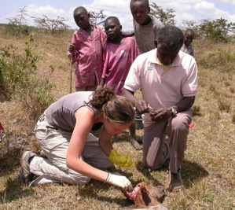
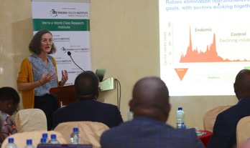
Introductions
Katie Hampson:
Then: as a PhD student
Usually somewhere exciting, collecting data
Now: as a Professor
Occasionally somewhere exciting, but usually in a meeting
katie.hampson@glasgow.ac.uk

Slide 3
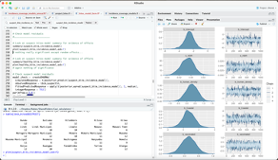
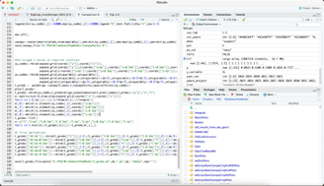
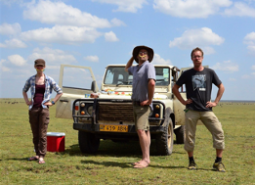
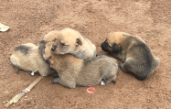
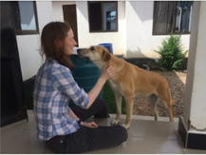
Introductions
Elaine Ferguson:
Then: as a PhD student
Usually staring at equations/R code.
Occasionally in Tanzania to hang out with wildebeest
Now: as a Postdoc
Still staring at (better!) R code.
Occasionally in Tanzania to hang out with dogs
elaine.ferguson@glasgow.ac.uk

Slide 4
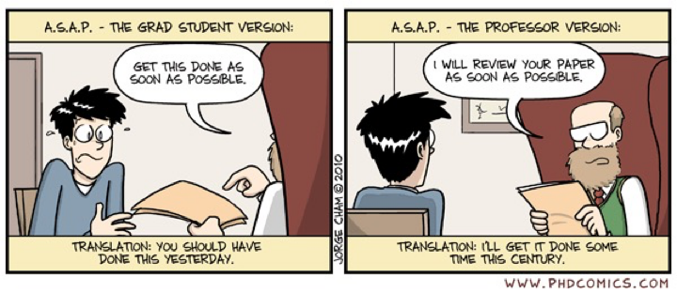
The PhD journey
What is your supervisors advising style?
How often will you meet?
What is your role at/ pre/ post meetings?
Notes:
bonus https://www.nature.com/articles/nj7331-570a (supervisor maintenance)
SET EXPECTATIONS
REMEMBER YOUR ADVISOR WILL FORGET WHAT YOU DISCUSSED / AGREED IN MEETING .... You must manage & drive your PhD!

Slide 5
The PhD journey
Don’t lose sight of the ‘so what’ question!
Notes:
SET EXPECTATIONS
REMEMBER YOUR ADVISOR WILL FORGET WHAT YOU DISCUSSED / AGREED IN MEETING .... You must manage & drive your PhD!

Slide 6

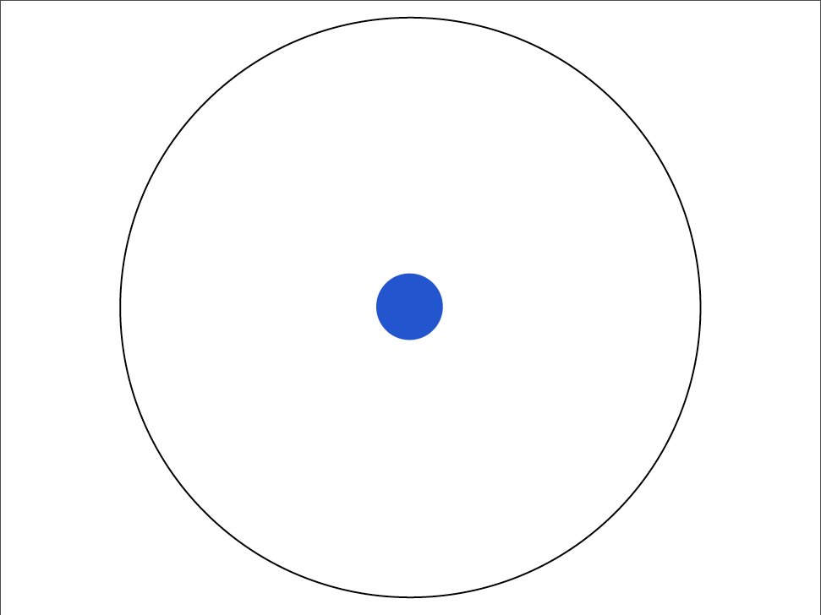
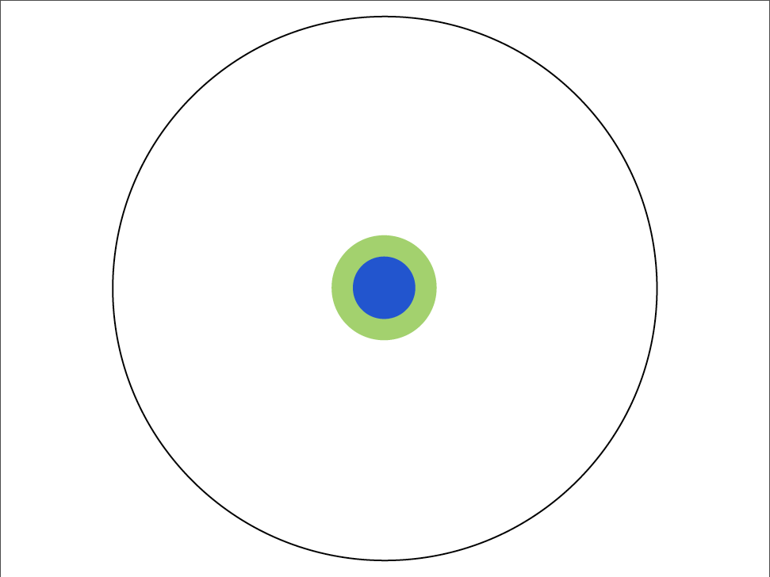
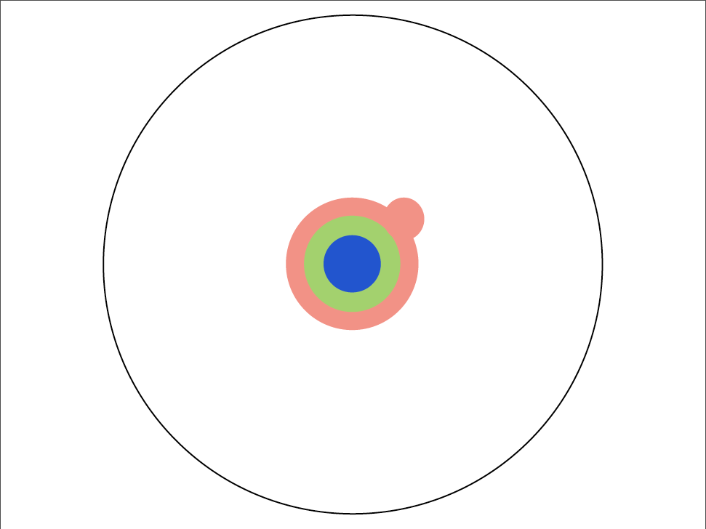
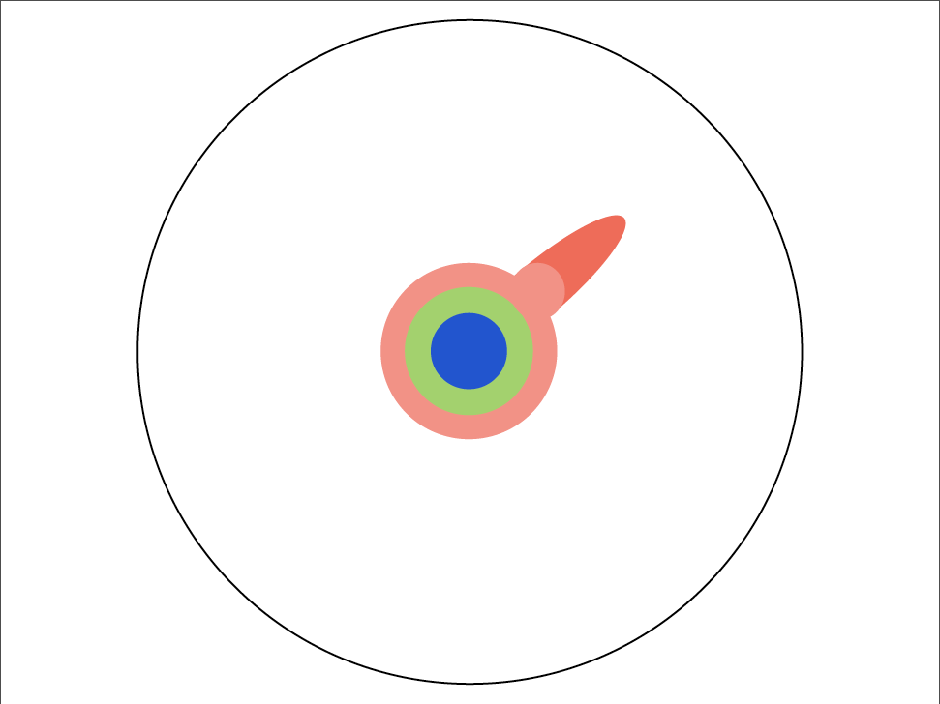
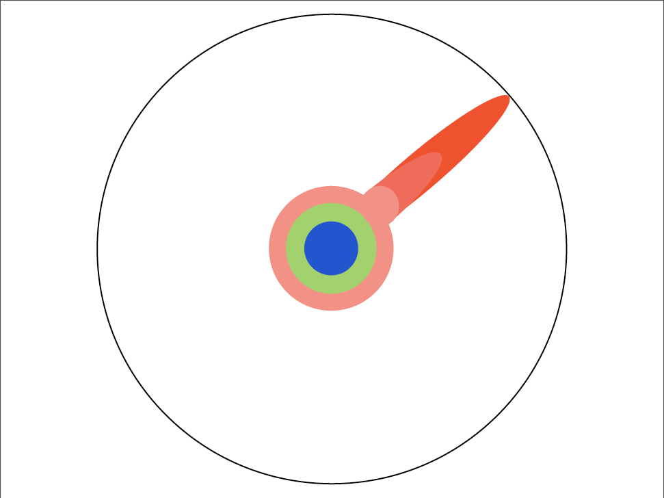
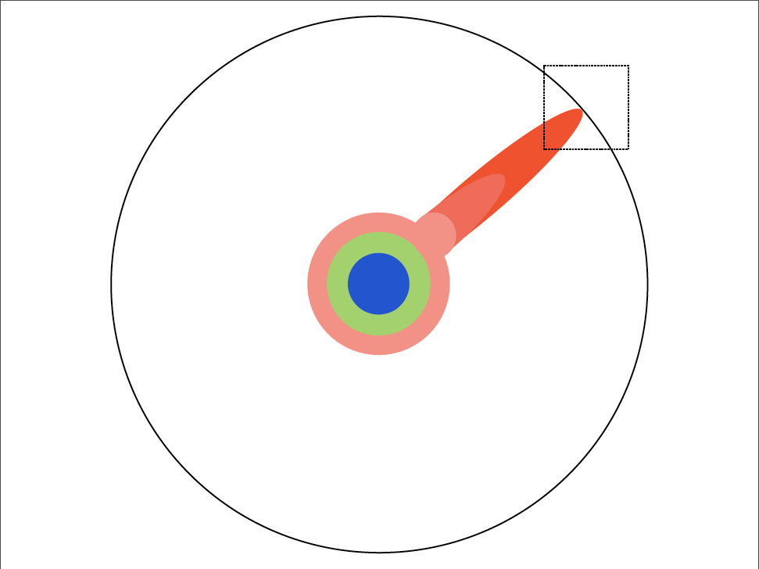


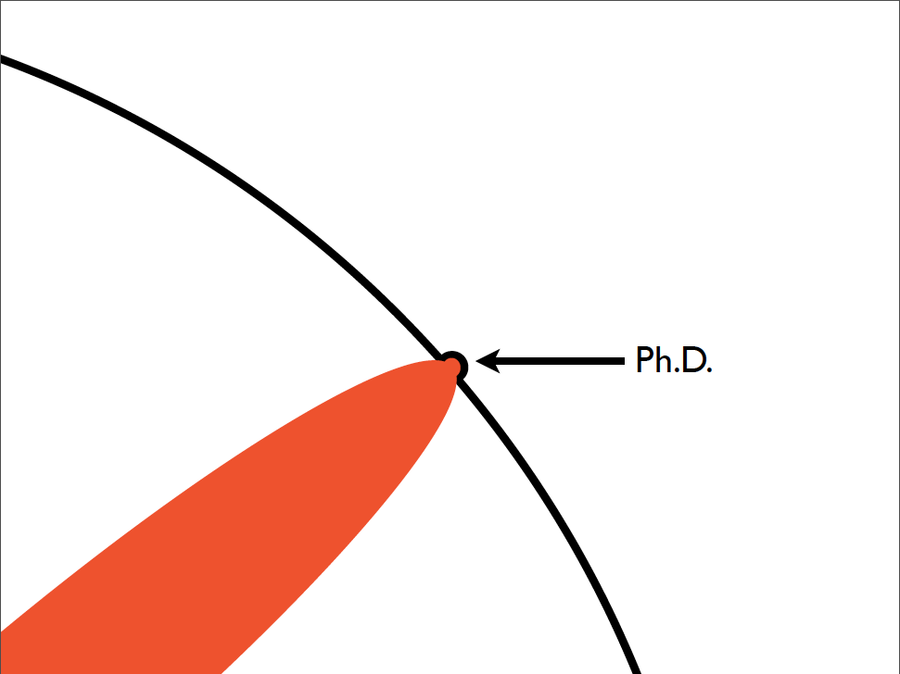

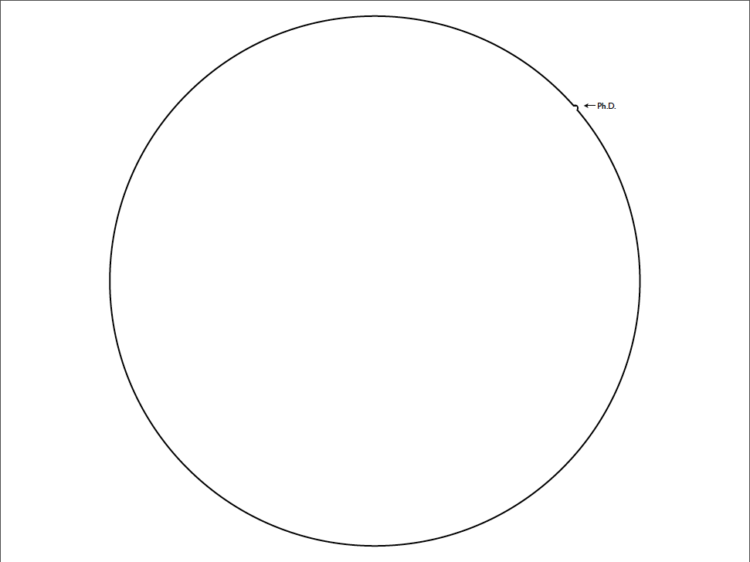
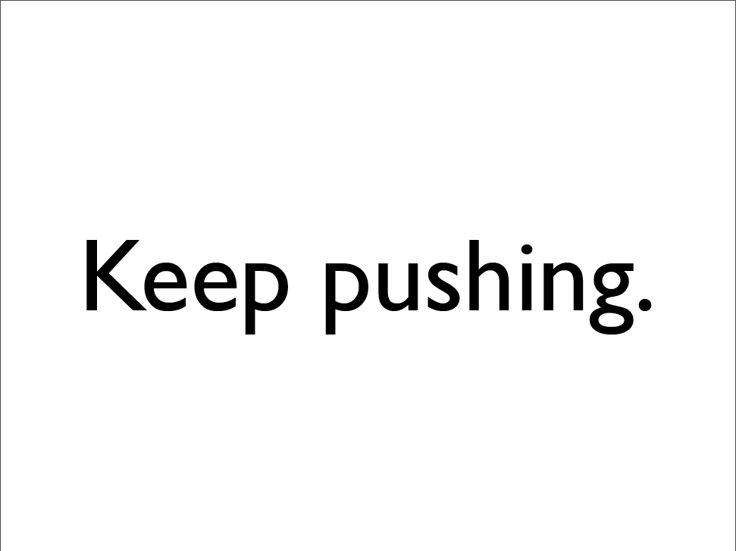
The PhD journey
Don’t lose sight of the ‘so what’ question!
Notes:
SET EXPECTATIONS
REMEMBER YOUR ADVISOR WILL FORGET WHAT YOU DISCUSSED / AGREED IN MEETING .... You must manage & drive your PhD!

Slide 7
The PhD journey
What is your supervisors advising style?
Do you know your advisors approach to the thesis?
Many but not all take the ‘thesis by manuscript’ approach
i.e. 3+ chapters with data!
All will need analysis/ visualization by code!

Slide 8
Your experiences of reproducible science!
Have you contributed to a manuscript?
Have you collected/ generated data?
and shared these data?
Do you code?
have you shared your code/ used others code?
Are you a Github user?
Do you expect to do any of these things in your PhD?

Slide 9
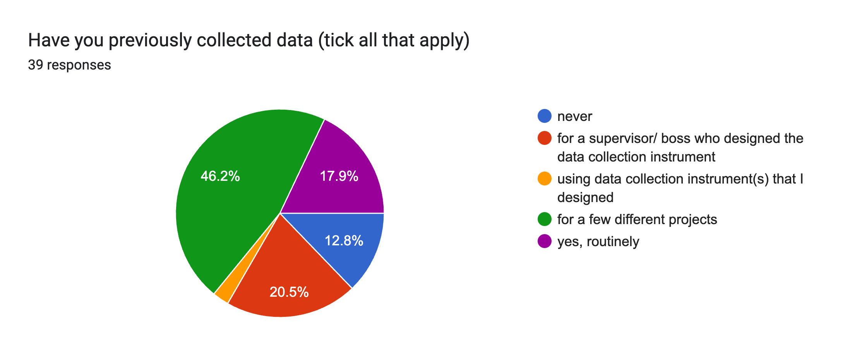
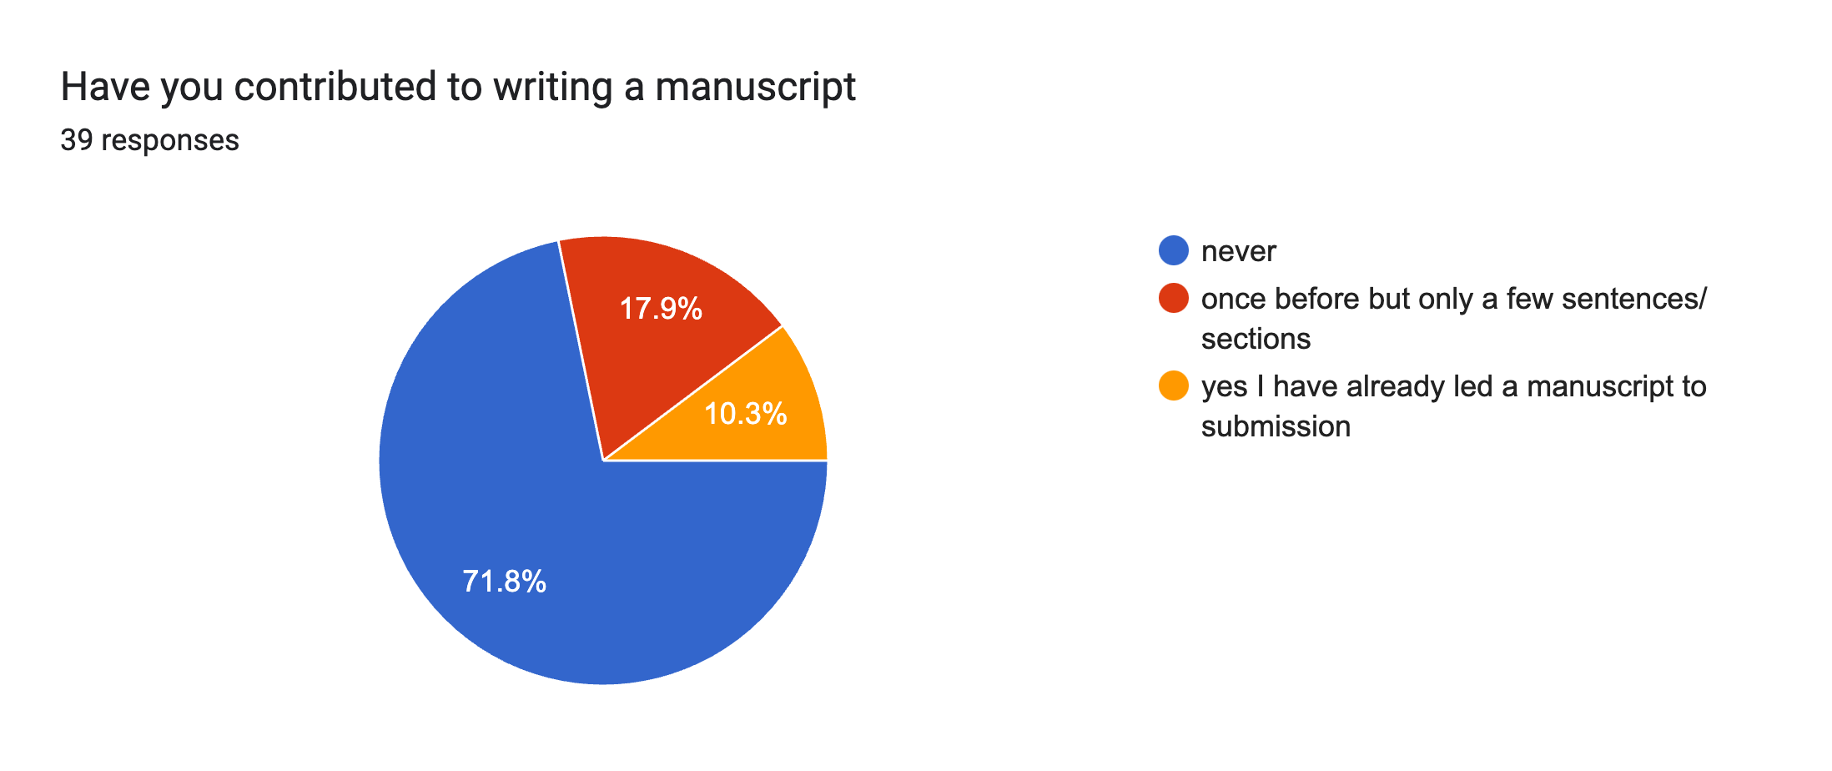
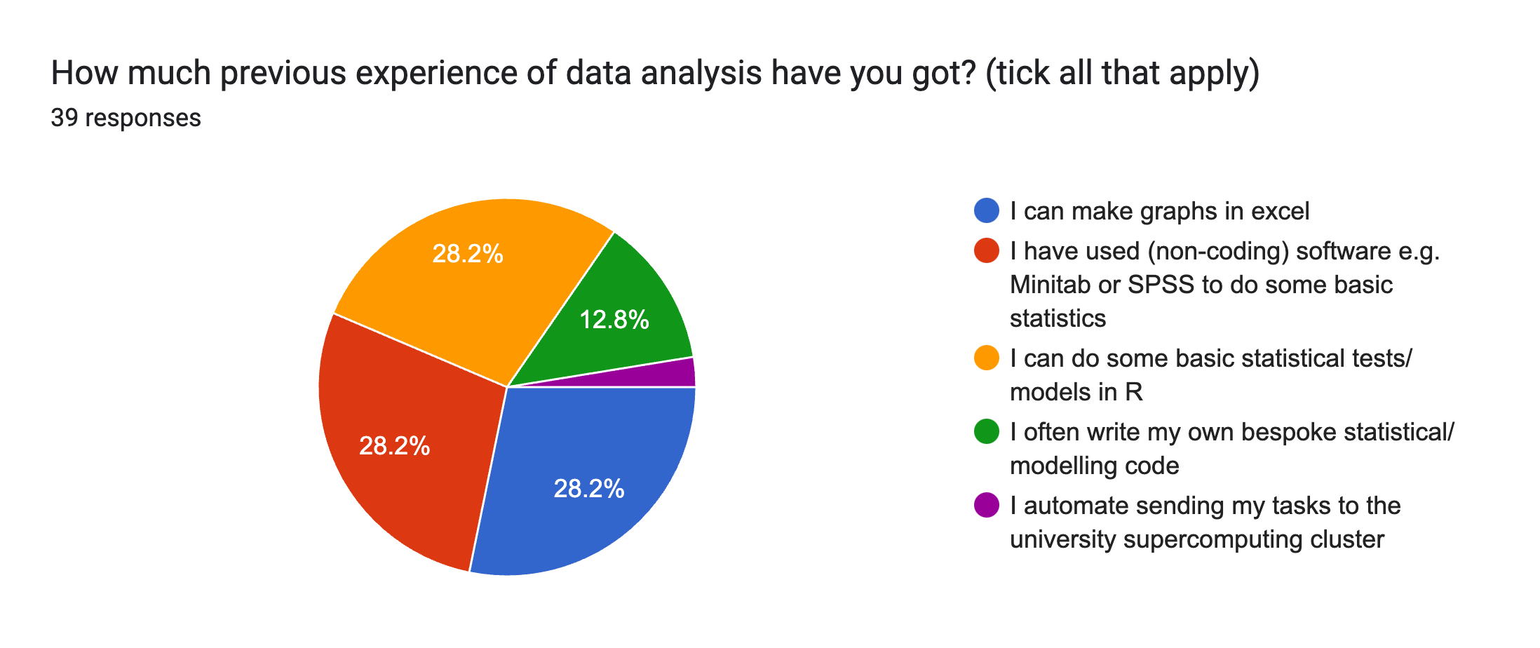
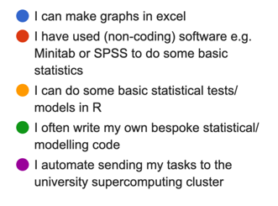
Data collection
Your experiences of reproducible science!
Writing manuscripts
Data analysis

Slide 10
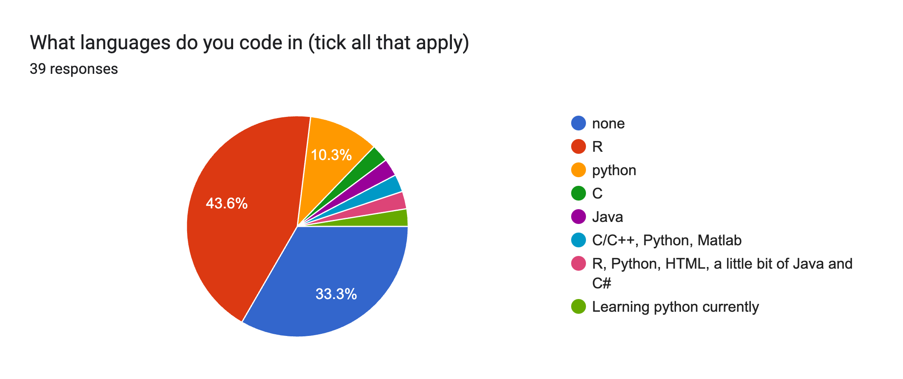
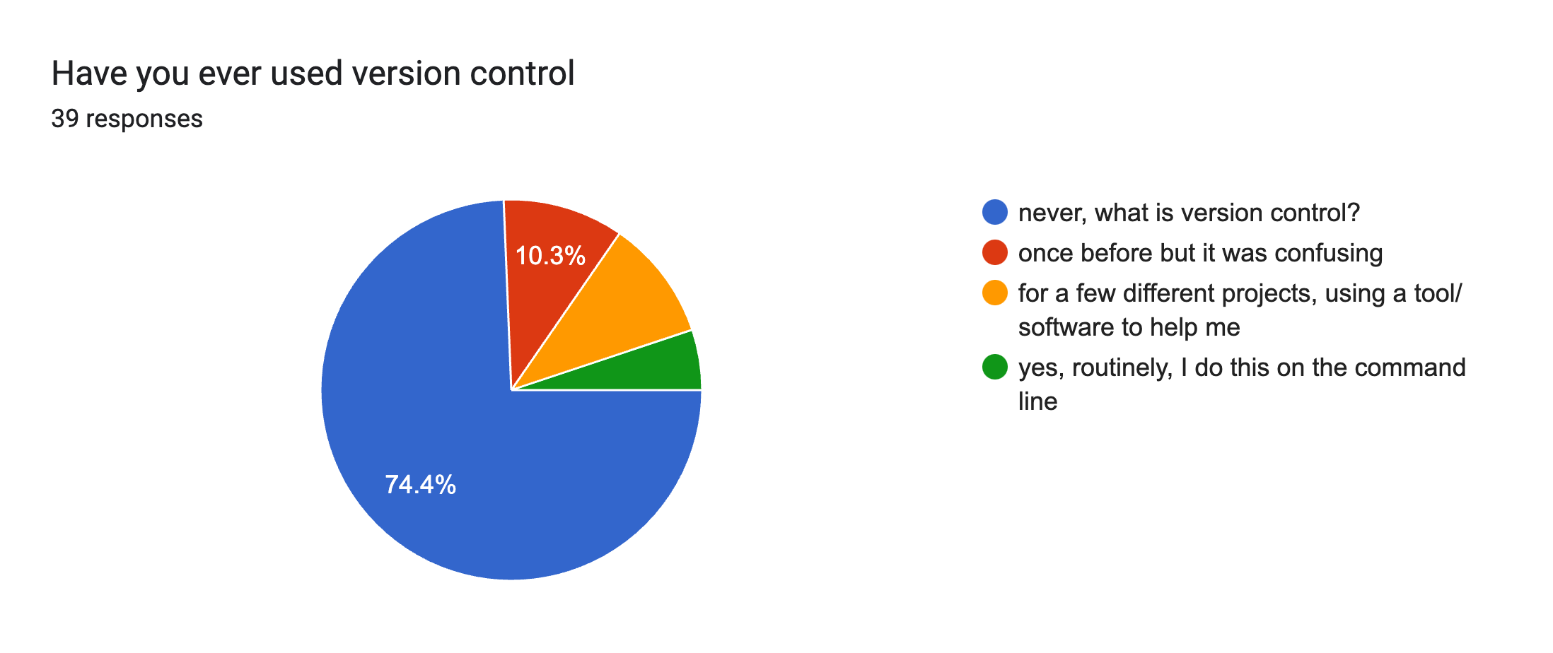
Coding
Your experiences of reproducible science!
Version control

Slide 11
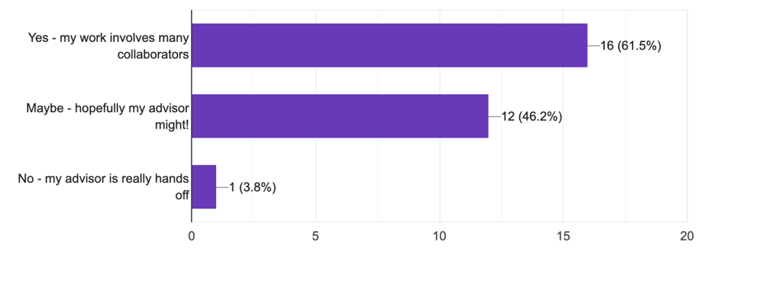
Future collaborators
Your experiences of reproducible science!

Slide 12
What does that even mean? Describe issues of working with other people’s (& your own) data Describe issues of working with other people’s (& your own) code
Collaborative & Reproducible PhD?
Breakout groups for 5 minutes
After 5 minutes each group will report back to everyone
(how much did you know before the pre-reading?)
Notes:
Pre-reading: https://www.nature.com/articles/d41586-019-03335-4 (open science intro & refs within)

Slide 13
What does that even mean? Describe issues of working with other people’s (& your own) data Describe issues of working with other people’s (& your own) code
Collaborative & Reproducible PhD?
“Future you is your most important collaborator, but ….…. Future you does not respond to email”
Notes:
Pre-reading: https://www.nature.com/articles/d41586-019-03335-4 (open science intro & refs within)

Slide 14
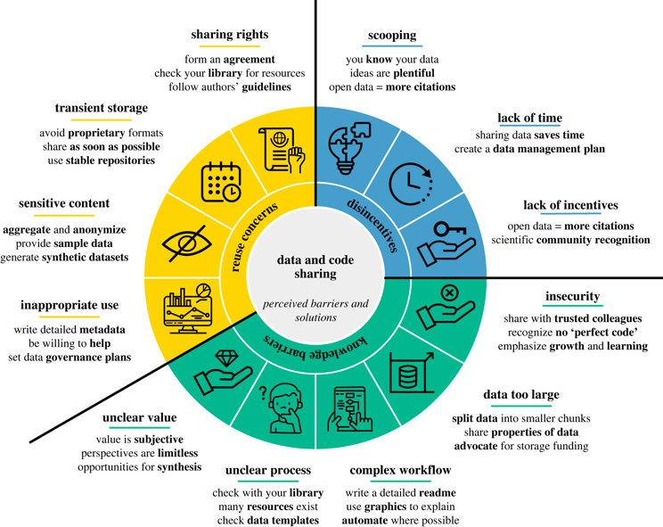
Why we do not share code & data!
Gomes et al. 2022 https://doi.org/10.1098/rspb.2022.1113

Slide 15

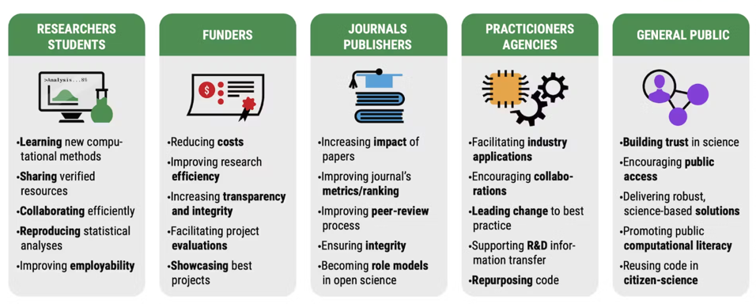
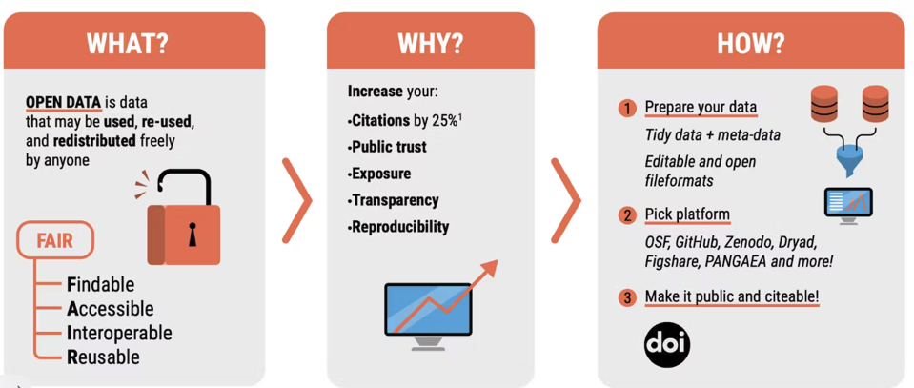
Why we should share code & data!
https://www.sortee.org/

Slide 16
Basic good practice
Academic research is changing:
Peer review: Publications -- Preprints
Archiving: black hole -- data & code available
Access: Commercial -- Open
Individual: -- Collaborative
Authorship: -- still a mess (but use CRediT)!
When you publish your work:
Data (in de-identified format) should be shared publicly
Code to reproduce analyses should be shared
Using Github and working collaboratively:
Allows collaborators to check & improve your code
Find errors BEFORE publication
Confidence that your analyses are correct
You learn how to code better by reading others code
Makes publication much easier
Just make your repo public (with de-identified data)!

Slide 17
Github Practical
Why version control?
Everyone working from the same set of files
No emails with big files attached
In a common system, workflows are much easier to navigate!
Private & public repos
GDPR compliant!

Slide 18
Getting started with GitHub
Make sure your Rstudio is linked with R and both are up-to-date
Create a GitHub account https://docs.github.com
Install GitHub Desktop
https://docs.github.com/en/desktop/installing-and-authenticating-to-github-desktop/installing-github-desktop
Link GitHub Desktop to your Github Account

Slide 19
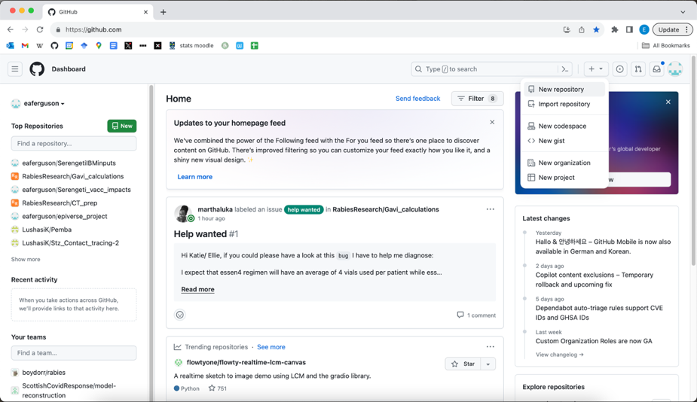
Creating a repository

Slide 20
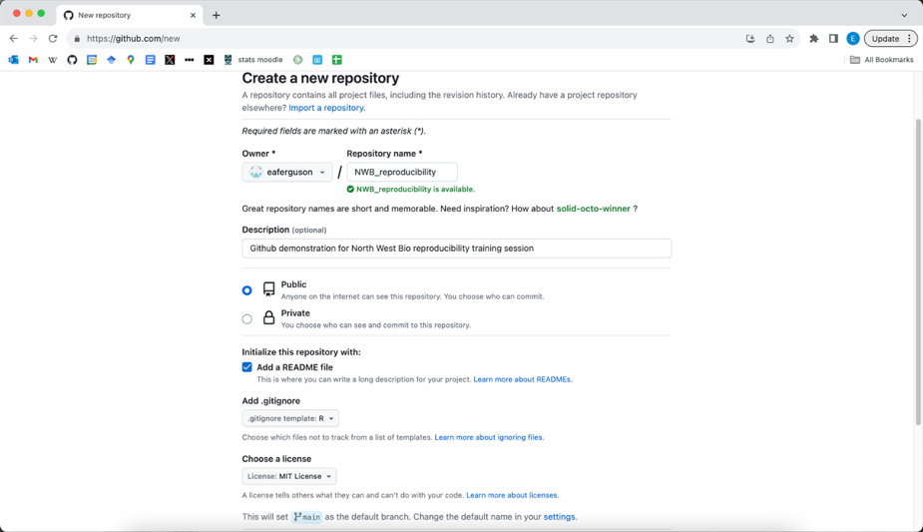
Creating a repository

Slide 21
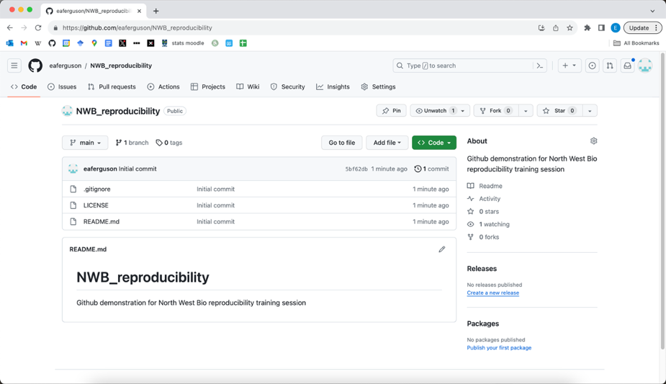
Creating a repository

Slide 22
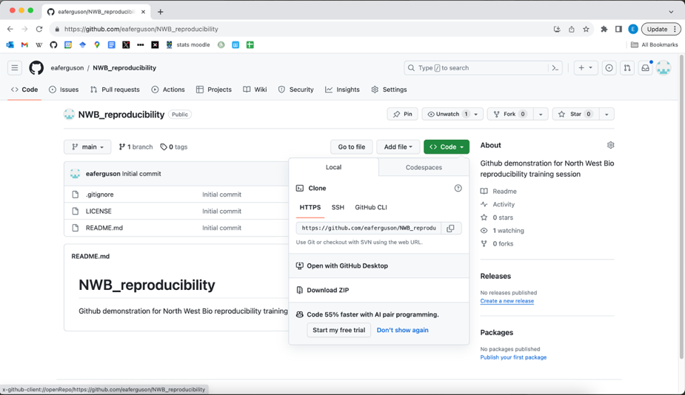
Clone repository using GitHub desktop

Slide 23
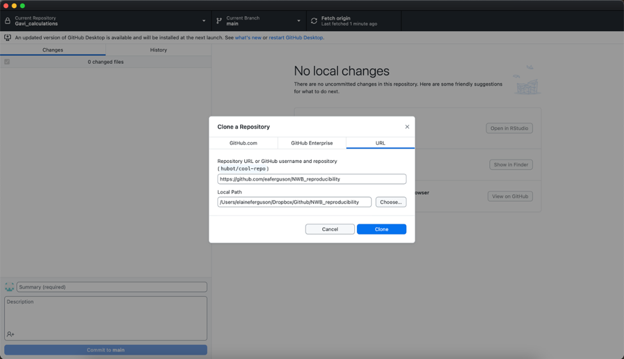
Clone repository using GitHub desktop
Repo URL
Local folder

Slide 24
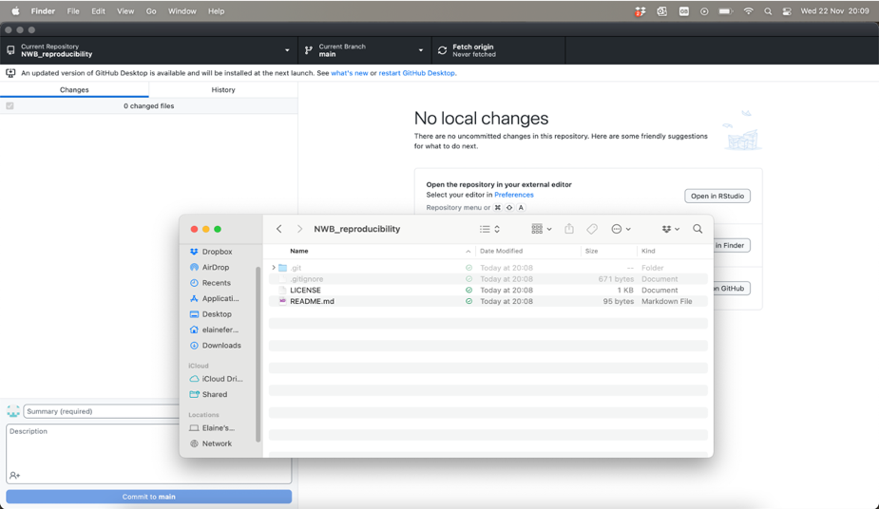
Clone repository using GitHub desktop

Slide 25
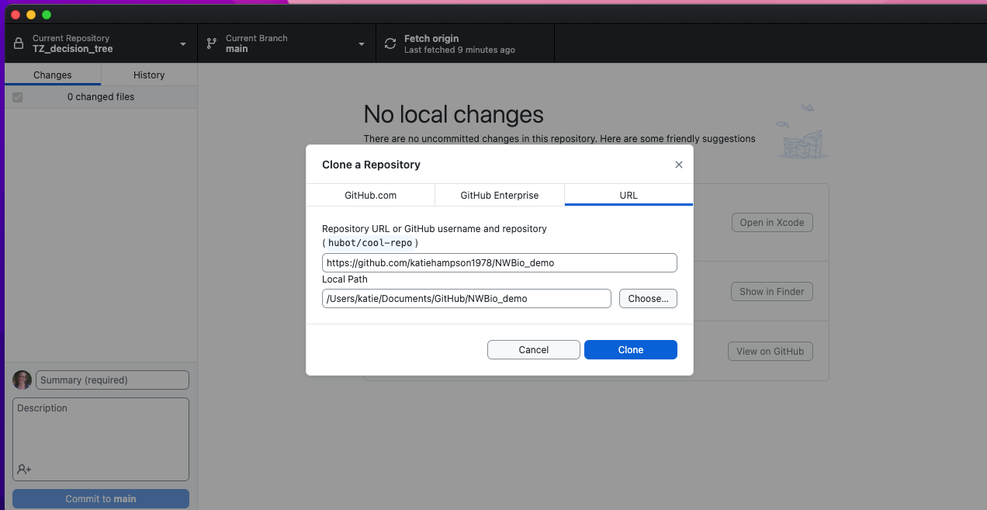
Now try to clone my repo!
URL: https://github.com/katiehampson1978/NWBio_demo

Slide 26
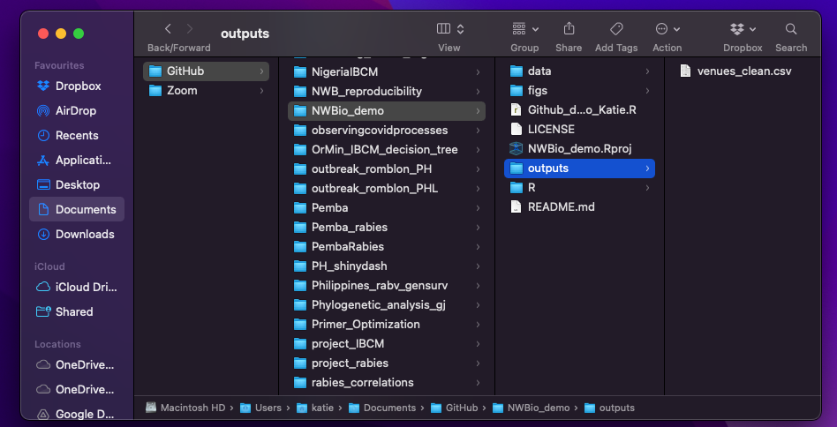
The saved code and outputs

Slide 27
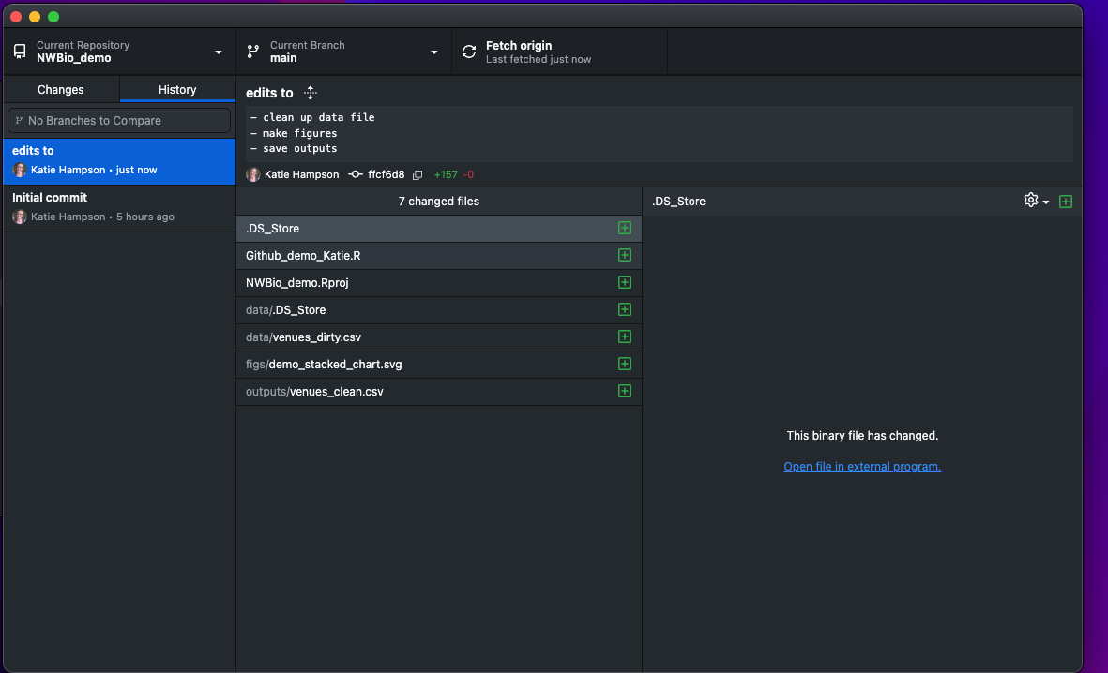
Updated via Github

Slide 28
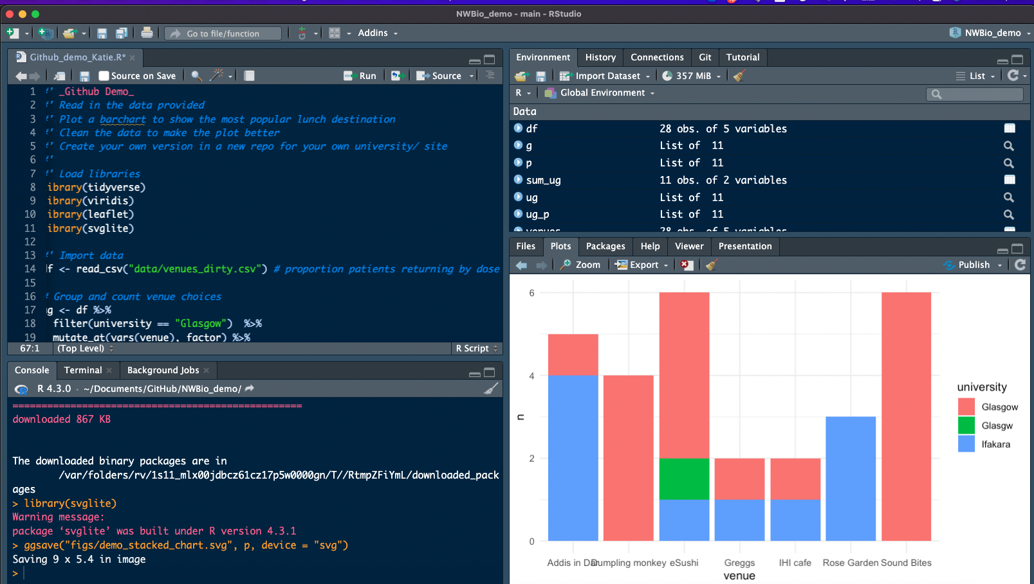
The code
Double click on NWBio_demo.Rproj to open the project in Rstudio
Go to the files pane (bottom right) and open Github_demo_Katie.R

Slide 29
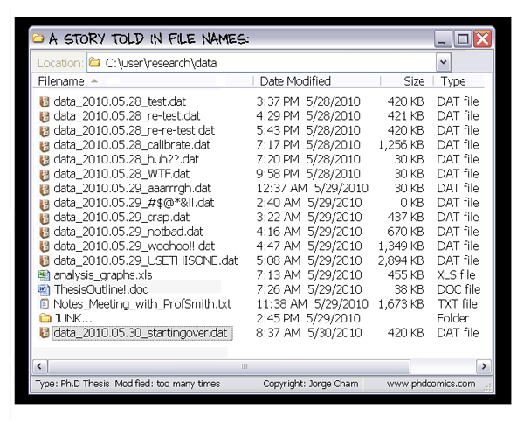
Do you have a folder like this…..?

Slide 30
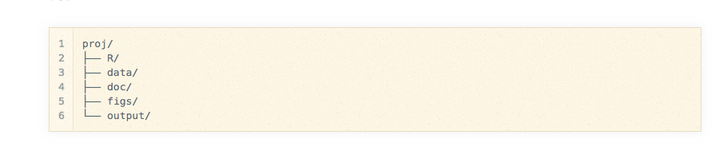
Note there is a system to help work effectively:
Keep raw data in data folder. Do not edit!
Archive older data (& code) just in case

Slide 31
Also note some basic good practice (project management)
Provide a README!
Use a clear folder structure
Create an Rproj
Save outputs e.g. saveRDS
Use informative file & folder names
Separate raw data from processed data

Slide 32
Can you run the code?
What does each code section do?
What is saved and where?
What needs fixing?

Slide 33
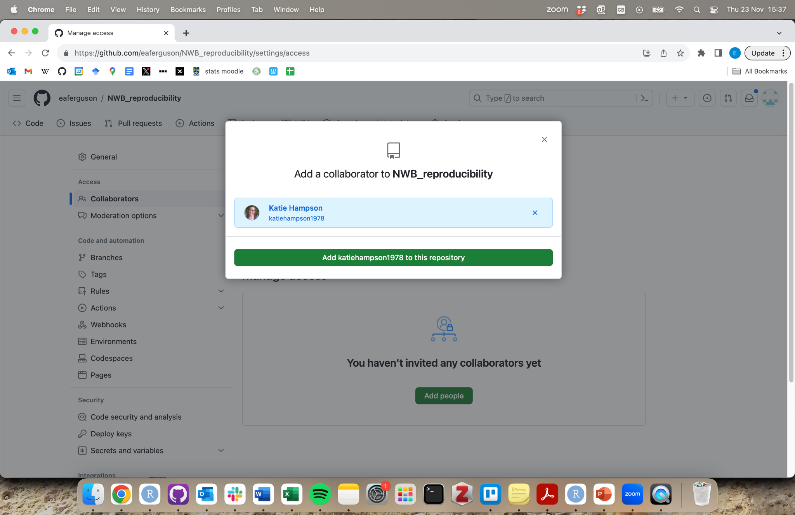
Add collaborators
To allow others to make changes to your repo, navigate to: Settings/Collaborators

Slide 34
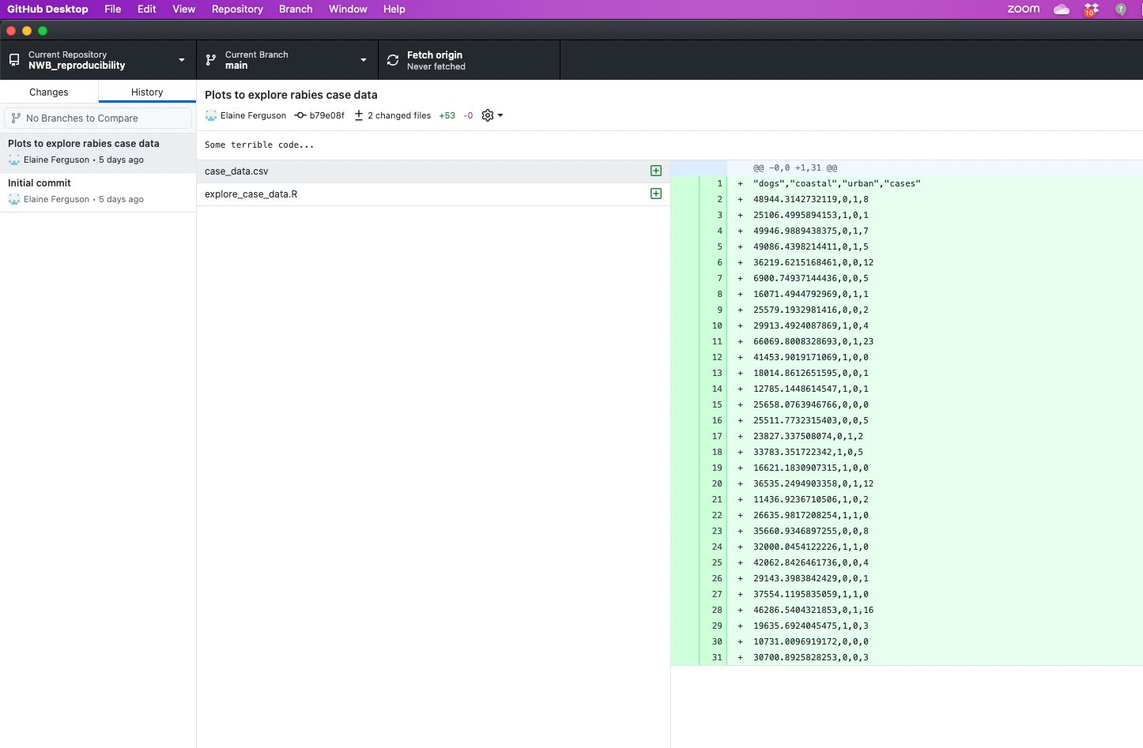
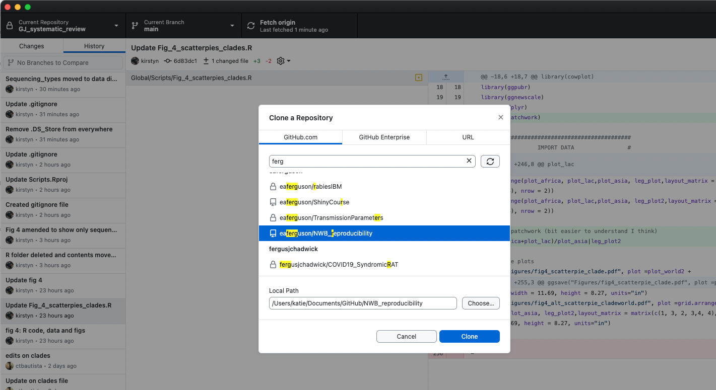
Collaborator accepted invite & cloned repo

Slide 35
Create your own repo
In groups:
Create a new Github repo for creating and analysing your own voting data using one group member’s account.
Invite all other group members to be collaborators
All clone your new repo

Slide 36
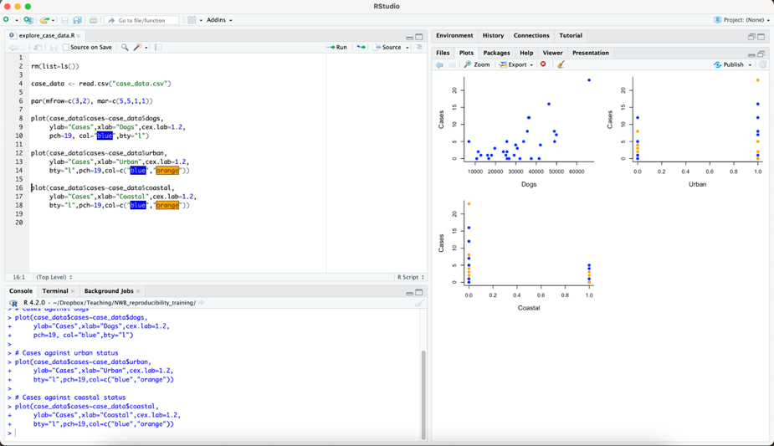
Adding to your repo
Here, Elaine is adding some data and code to create some simple plots

Slide 37
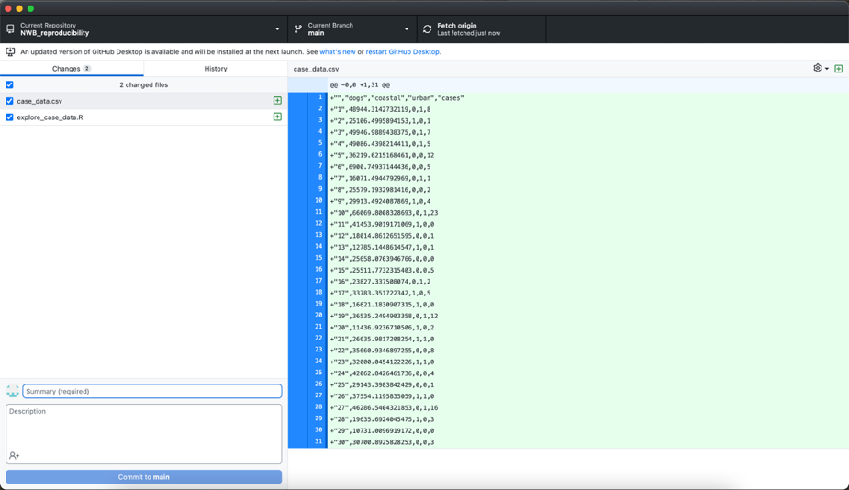
Changes to your local repo are visible in GitHub Desktop

Slide 38
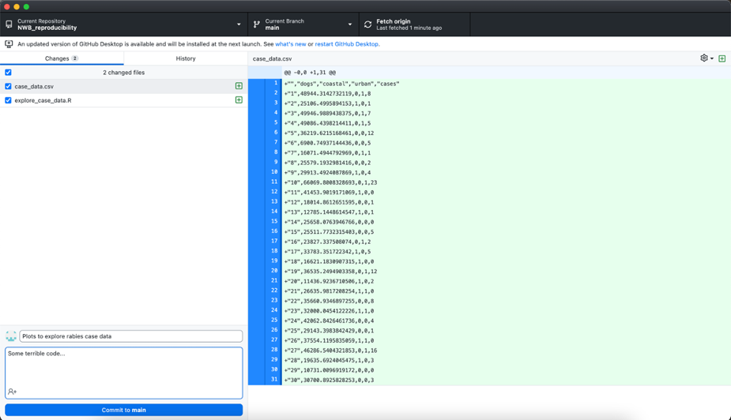
Commit the changes locally

Slide 39
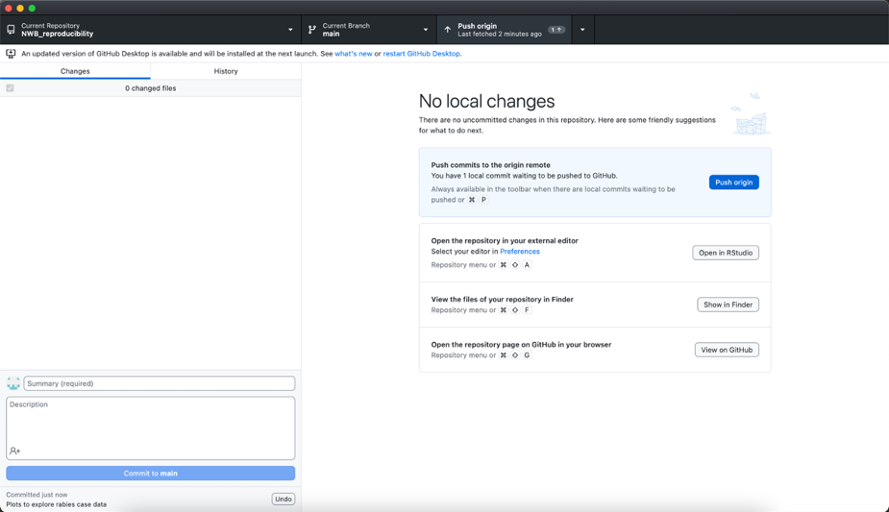
Push the changes to GitHub

Slide 40
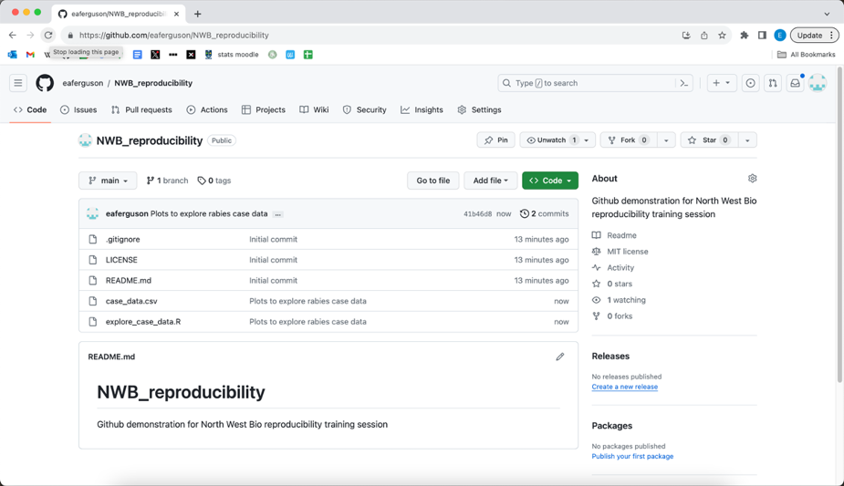
Push the changes to GitHub

Slide 41
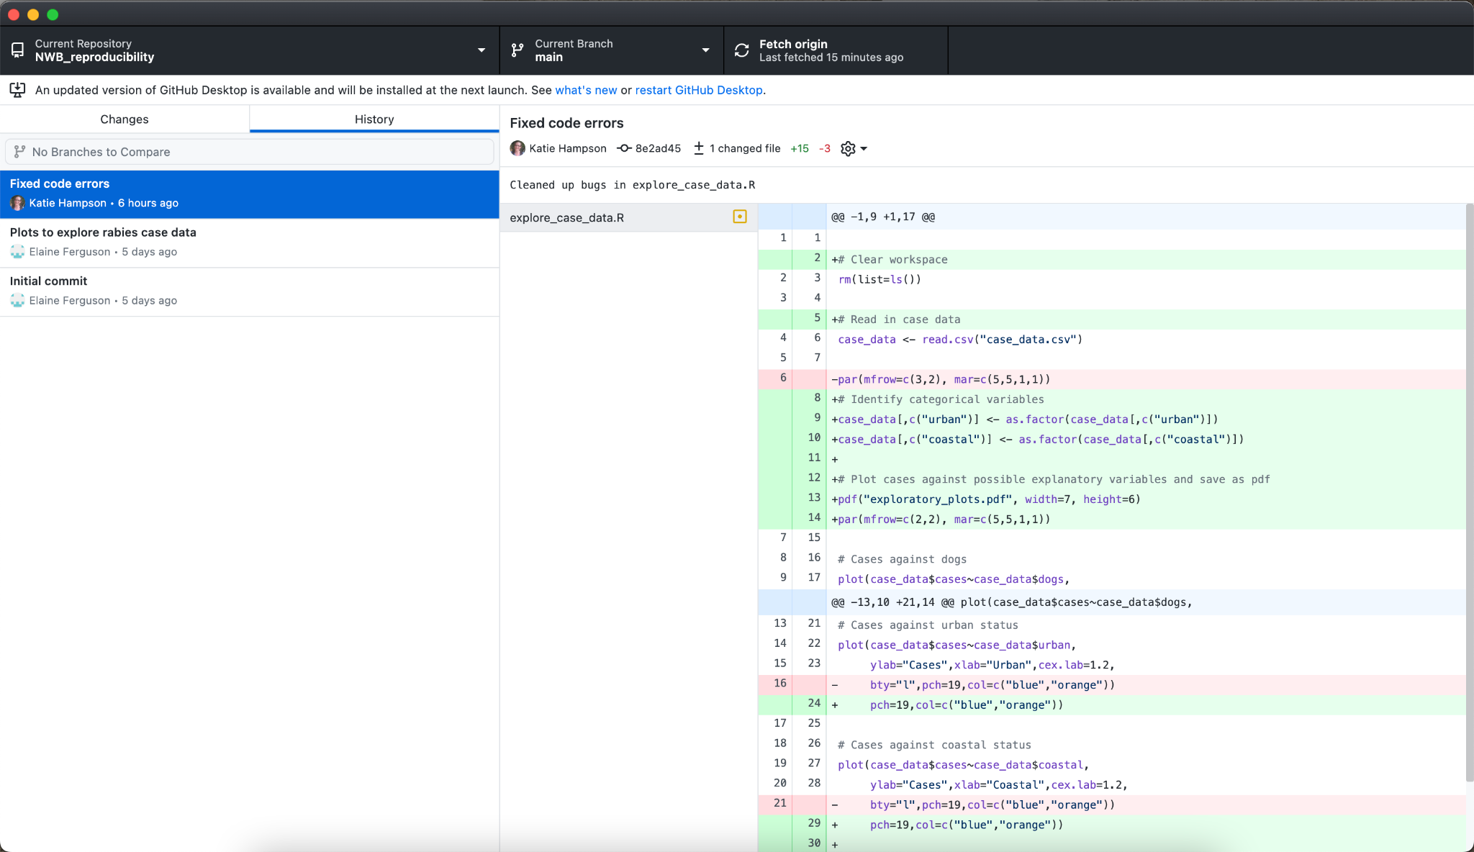
Collaborators fetch and pull changes from GitHub
Now everyone has a copy of the most recent files downloaded from Github to their local repo

Slide 42
Adding data to your repository in collaboration with your group
Have one group member create a spreadsheet with ~5 rows of made-up voting data, similar to the example repo you cloned earlier. Save locally (in a folder named “data”), commit, and push to GitHub.
Another group member should fetch and pull the new data file, open it in excel and add some more rows of data, save, and push back to GitHub
Repeat 2. until everyone has had a go at adding and pushing some data. Don’t be tempted to have multiple people editing the file at the same time!!
Make sure everyone pulls the final version of the data

Slide 43
Explore your new data using R
Work together in your groups to create a new R project (open a new RStudio window, and look in the top right corner) and develop an R script based on the one in the example repo that:
Reads in your data
Creates a barplot of votes for each option
Saves the barplot as a .svg file
Don’t worry if not everything looks perfect immediately – you’ll fix it up later!
Commit and push the script from whoever’s local repo it is saved in to GitHub
Everyone else fetch and pull from GitHub, and try and run the script in RStudio on your machine

Slide 44
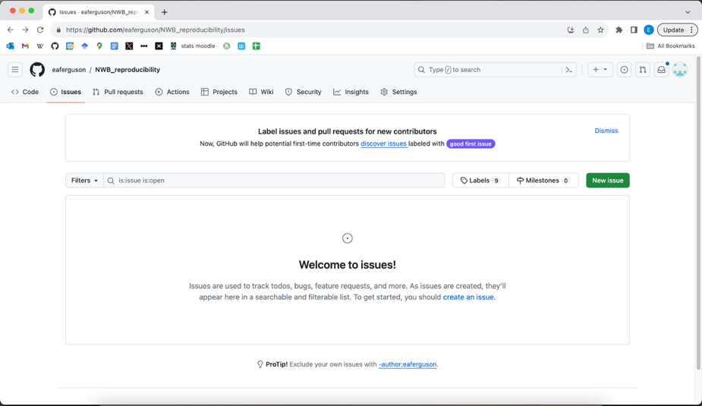
GitHub issues

Slide 45

Creating an issue

Slide 46

Creating an issue: Assigning

Slide 47

Creating an issue: Labels

Slide 48

Creating an issue

Slide 49

Collaborator receives issue notification

Slide 50


Collaborator corrects some errors in the code
& pushes correction back to repo

Slide 51

Collaborator corrects some errors in the code
& pushes correction back to repo

Slide 52

Collaborator closes the issue

Slide 53
Creating and resolving issues
Everyone create an issue for your repo and assign it – either to yourself or another group member (make sure everyone is assigned at least one).
Examples:
Update the README to provide more info about the repo
Fix a bug you noticed while trying to run the code
Change the plot colour
Create a rival plot in your favourite alternative software…
Work on fixing your assigned issue (trying not to work on the same file at the same time as someone else) and push the changes to GitHub
Mark your issue as resolved

Slide 54
Recovering lost files
Disaster strikes – someone has accidentally deleted the data file from your repo and everyone has already pulled the change.
How do we recover the file?

Slide 55

Recovering lost files
Go to your GitHub repo online, and look through the commits to find the one where the file was deleted

Slide 56

Recovering lost files
Go to your GitHub repo online, and look through the commits to find the one where the file was deleted

Slide 57

Recovering lost files
Go to the preceding commit and select “Browse repository at this point”

Slide 58

Recovering lost files
Locate and click on the deleted file in the old version of the repository

Slide 59

Recovering lost files
Download the deleted file:
Add the downloaded file back into your repo and push back to GitHub. Everyone can the pull the restored file.
In your groups, try deleting the data file from your repo and recovering it from GitHub.

Slide 60
Bonus R trick!

Slide 61
Did the venue preference barchart work?
6
4
university
n
Glasgow
Ifakara
2
0
Addis in Dar
Dumpling monkey
eSushi
Greggs
IHI cafe
Rose Garden
Sound Bites
venue
Is there anything you might need to edit when you present this work?

Slide 62
Did you know that svg files are editable!!!
6
4
university
n
Glasgow
Ifakara
2
ARGH?
0
Addis in Dar
Dumpling monkey
eSushi
Greggs
IHI cafe
Rose Garden
Sound Bites
venue
Glasgw

Slide 63
- Format shape
- Click and edit!
6
4
university
Glasgow
n
Glasgw
Ifakara
2
0
Dumpling monkey
eSushi
Greggs
IHI cafe
Sound Bites
venue
Addis in Dar
Rose Garden

Slide 64
6
4
university
n
Glasgow
Ifakara
2
0
Addis in
Dar
Dumpling
monkey
eSushi
Greggs
IHI cafe
Rose
Garden
Sound
Bites
venue

Slide 65
6
4
university
n
Glasgow
2
0
Dumpling
monkey
eSushi
venue
Greggs
Sound Bites

Slide 66
Github Learning:
How to navigate the Github website
Ideas about a sensible folder management structure
How to push/pull, commit/fetch in Github desktop
How to make, clone & join a Github repo
How to use issues
How to recover a lost file using version control
How to make a svg file in R that is editable
Notes:
TO DO
Find out the R experts & make sure they are present!
Make sure everything installed – Github desktop, R , Rstudio
Follow links that Elaine sent to connect (step 3 on desktop)
Make sure people open Github_demo.proj
Install packages too!

Slide 67

😱 😡 😩 😭

Slide 68

😱 😡 😩 😭

Slide 69

😡😱😩😭

Slide 70

Basic good practice (code)
... don’t let perfect be the enemy of good!
Don’t let your code/data/project become a procrastination crutch.
Your approach has to support you to collaborate & work effectively

Slide 71

Basic good practice (data)
Write a data dictionary (& add it to your repository!)
Use appropriate fields/ headers
Use csv files (or other appropriate interoperable data)
Avoid spaces in names
Format data for analysis (avoid pretty excel formatting!)
Separate raw data from processed data

Slide 72


Great resources available!
https://www.sortee.org/
Big thanks to Ed Ivimey-Cook (here in Glasgow!)
Notes:
https://www.mentimeter.com/app/presentation/alyfyzphahmeghsh8rekacjr7h8qsimy/j3phra5fy6ry
https://osf.io/jgeq9/
https://sorse.github.io/blog/a-reproducible-phd/
https://blogs.ucl.ac.uk/phd-research-gosich/tag/reproducibility/
https://lauriebaker.rbind.io/courses/
https://laurielbaker.github.io/reproducible_reports/

